Slide 1
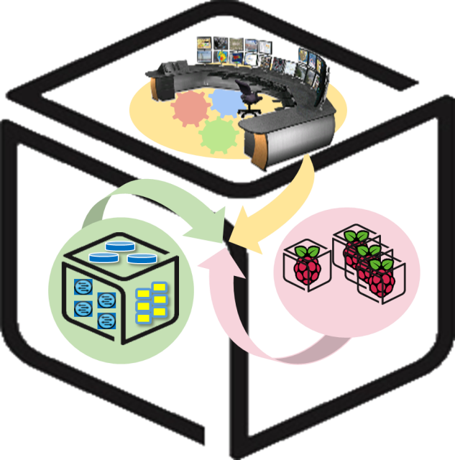
SmartX Labs for Computer Systems
Cluster & Analytics Lab
(2018, Spring)
NetCS Lab

Slide 2
History and Contributor of Cluster Lab
(2017. 05. 20.)
Version | Updated Date | Updated Contents | Contributor
- | 2015/10 | (구) Analytics Lab 작성 | 송지원
v1 | 2016/04 | Cluster Lab 초안 작성 | 김승룡
v2 | 2016/05 | Cluster Lab 수정 | 송지원
v3r3 | 2016/05/28 | Cluster Lab 2차 수정 (내용 수정 및 추가) | 송지원
v4r1 | 2016/05/30 | Cluster Lab 3차 수정 (피드백 반영) | 송지원
v5 | 2016/06/01 | HDFS를 옵션으로 변경, 기타 문제 수정 | 송지원
v6r1 | 2016/06/03 | 실습자 검수 후 수정 | 송지원, 윤희범, 남택호
v6r2 | 2016/06/29 | HDFS 설치 과정 등 수정 | 송지원
v6r3 | 2016/06/30 | Zeppelin 독립 실행 모드 설명 추가 | 송지원
0.6.4 | 2016/07/04 | Zeppelin 설치 방법 누락된 부분 추가 | 송지원
0.6.5 | 2017/05/20 | Ubuntu 16.04, Spark 2.1.1-Hadoop-2.7, Zeppelin 0.7.1, Hadoop 2.8.0 대응 업데이트 | 강문중
0.6.6 | 2018/05/30 | 소프트웨어 버전 업데이트, 강의 시나리오 반영하여 그림 변경, 이론 보강 | 권진철

Slide 3






CSLab: Cluster & Analytics Lab.
- Goal
SETUP to run data processing and visualization
with Mesos, Spark, Zeppelin, (HDFS)

Slide 4
Apache Mesos - Concept
What is Mesos?
Apache Mesos is an open-source project to manage computer clusters.
Mesos abstracts CPU, memory, storage, and other compute resources away from machines (physical or virtual), enabling fault-tolerant and elastic distributed systems to easily be built and run effectively.
Mesos is built using the same principles as the Linux kernel, only at a different level of abstraction. The Mesos kernel runs on every machine and provides applications (e.g., Hadoop, Spark, Kafka, Elastic Search) with API’s for resource management and scheduling across entire datacenter and cloud environments.
Cloud as a single computer
Share resources across the machines

Slide 5

Apache Mesos - Architecture
1
I need 2 CPUs!
Framework
3
Framework, use 2 CPUs in Slave 1
Mesos Master
2
I have 2 CPUs
Mesos Slave 1
Mesos Slave 2
Mesos Slave 3

Slide 6
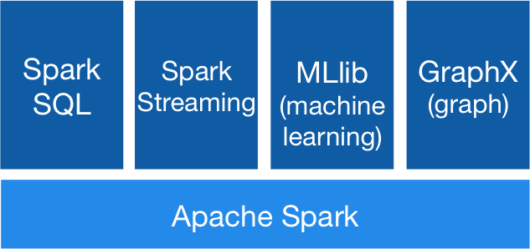
Apache Spark - Concept
Apache Spark™ is a fast and general engine for large-scale data processing.
In-memory data processing framework: Fast!
Easy to use, community fastly growing
Libraries: SQL and DataFrame, Streaming, MLlib, GraphX
Run on standalone or Mesos, Yarn, etc
Scala, Java, Python

Slide 7
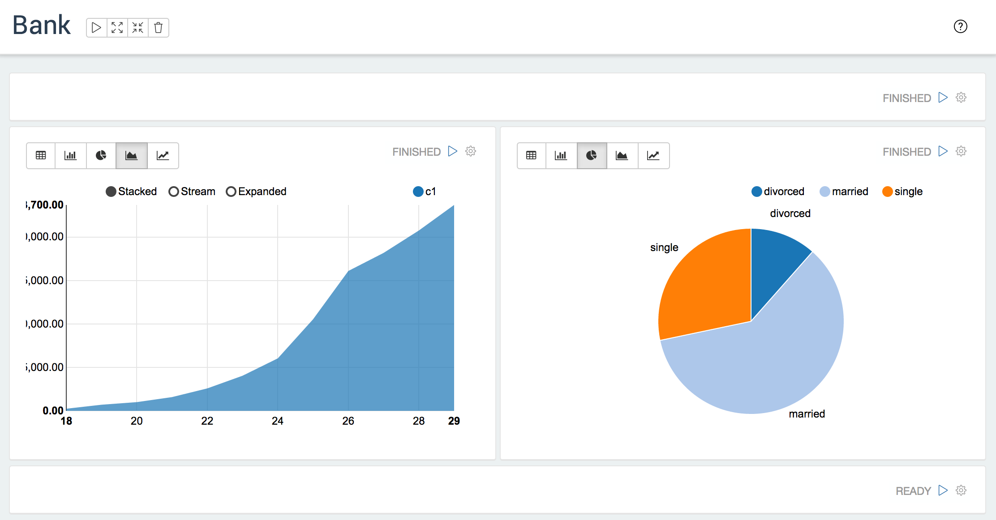
Apache Zeppelin
-Concept
A web-based notebook that enables interactive data analytics.
Support Spark

Slide 8

0. Cluster Overview
Prerequisite: Ubuntu 16.04 - 64bit
Spark
Zeppelin
Mesos Master
Zookeeper
HDFS NameNode
Mesos
Master
HDFS
DataNode

Slide 9
HDFS (optional) - Concept
Hadoop Distributed FileSystem
A distributed file system that provides high-throughput access to application data.
Features
Fault tolerance by detecting faults and applying quick, automatic recovery
Portability across heterogeneous commodity hardware and operating systems
Scalability to reliably store and process large amounts of data
Economy by distributing data and processing across clusters of commodity personal computers
Efficiency by distributing data and logic to process it in parallel on nodes where data is located
Reliability by automatically maintaining multiple copies of data and automatically redeploying processing logic in the event of failures

Slide 10
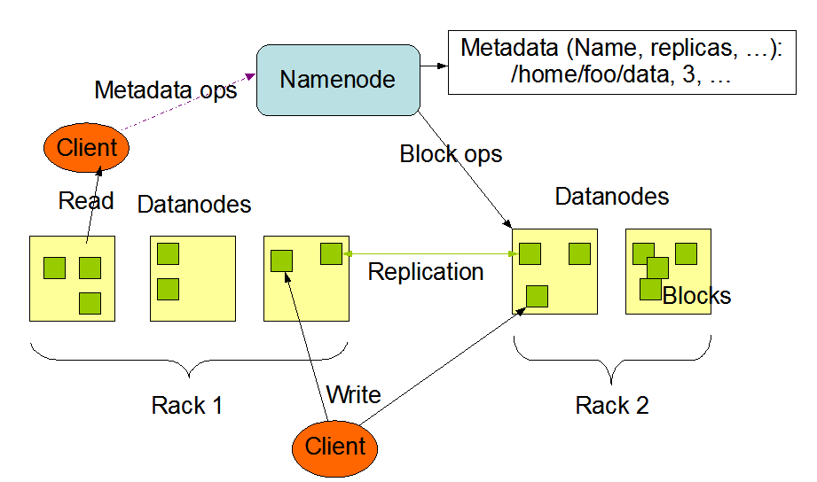
HDFS - Architecture
<Master/Slave architecture>
NameNode: A single node which manages the file system namespace and regulates access to files by clients.
DataNode: DataNodes manage storage attached to the nodes that they run on.

Slide 11


HDFS - Architecture
HDFS makes storages of separate machines in cluster into a single storage.
DataNode
DataNode

Slide 12


0. Preparation - Install Java and Mesos Dependencies
Install JDK 8 and other Apache Mesos Dependencies
sudo apt update
sudo apt-get install -y openjdk-8-jdk
sudo apt-get -y install build-essential python-dev python-six python-virtualenv libcurl4-nss-dev libsasl2-dev libsasl2-modules maven libapr1-dev libsvn-dev zlib1g-dev iputils-ping
Do this for all NUCs.

Slide 13
0. Preparation - Configure hostnames
From NUC 1 :
sudo hostname nuc01
From NUC 2 :
sudo hostname nuc02
Edit /etc/hosts from all NUCs :
sudo vi /etc/hosts
Append the following context into /etc/hosts :
127.0.0.1 localhost
(IP Address of NUC 1) nuc01
(IP Address of NUC 2) nuc02

Slide 14
1. Apache Mesos - Install
Mesos Master
Zookeeper
Mesos Slave

Slide 15
1. Apache Mesos - Installation Procedure
Add Mesosphere repository
Install Mesos Master on NUC 1
Install Mesos Slave on NUC 2
Check on Mesos Web UI

Slide 16
1. Apache Mesos - Install: Add Mesosphere repository
Add the repository to all NUCs.
sudo apt-key adv --keyserver keyserver.ubuntu.com --recv E56151BF
export DISTRO=$(lsb_release -is | tr '[:upper:]' '[:lower:]')
export CODENAME=$(lsb_release -cs)
To check you have correctly inputed, use the command below :
echo $DISTRO $CODENAME
Its result will be “ubuntu xenial”
echo "deb http://repos.mesosphere.io/${DISTRO} ${CODENAME} main" | sudo tee /etc/apt/sources.list.d/mesosphere.list
sudo apt update

Slide 17
1. Apache Mesos - Install: Mesos Master on NUC 1
sudo apt -y install mesos
echo manual | sudo tee /etc/init/mesos-slave.override
echo 0.0.0.0 | sudo tee /etc/mesos-master/ip
echo nuc01 | sudo tee /etc/mesos-master/hostname
echo zk://localhost:2181/mesos | sudo tee /etc/mesos/zk
echo <NAME> | sudo tee /etc/mesos-master/cluster
echo 1 | sudo tee /etc/zookeeper/conf/myid
sudo systemctl restart zookeeper
sudo systemctl start mesos-master
<NAME>: anything you want

Slide 18
1. Apache Mesos - Install: Mesos Slave on NUC 2
sudo apt -y install mesos
echo manual | sudo tee /etc/init/mesos-master.override
echo 0.0.0.0 | sudo tee /etc/mesos-slave/ip
echo nuc02 | sudo tee /etc/mesos-slave/hostname
echo zk://<NUC1 IP>:2181/mesos | sudo tee /etc/mesos/zk
sudo cp /etc/mesos/zk /etc/mesos-slave/master
echo HADOOP_HOME=/usr/local/hadoop | sudo tee –a /etc/default/mesos-slave
sudo systemctl stop zookeeper
sudo systemctl start mesos-slave
HADOOP_HOME will be needed later if you want to use Spark with HDFS.

Slide 19
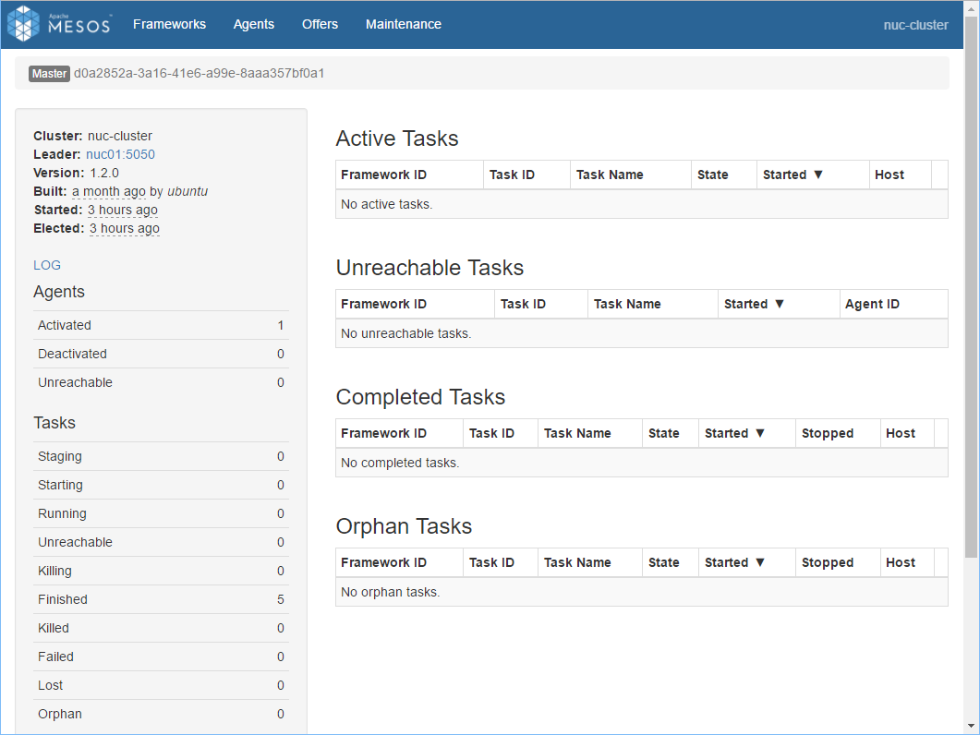
1. Apache Mesos - Check on Mesos Web UI
In your web browser, go to
http://<NUC 1 IP Address>:5050
Check activated slaves and resources.
Note : In case of using the browser from other than those 2 NUCs, “hosts” file must be updated for the computer like the previous “Configure hostnames” step.

Slide 20
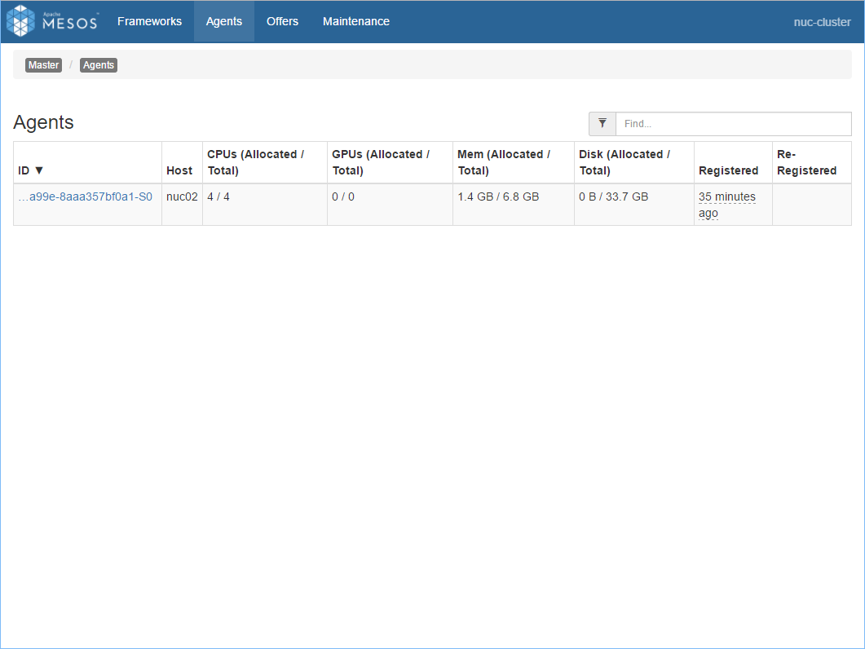
1. Apache Mesos - Check on Mesos Web UI
Agents tab shows NUC 2 registered as a slave

Slide 21
2. Apache Spark - Installation Procedure
Install on NUC 1
Test on NUC 1

Slide 22
2. Apache Spark - Install
2. On NUC 1, Download and unarchive Spark, and configure spark-env.sh and spark-default.conf file.
cd ~
wget http://apache.mirror.cdnetworks.com/spark/spark-2.2.1/spark-2.2.1-bin-hadoop2.7.tgz
tar xzf spark-2.2.1-bin-hadoop2.7.tgz
cd spark-2.2.1-bin-hadoop2.7/conf
cp spark-env.sh.template spark-env.sh
cp spark-defaults.conf.template spark-defaults.conf
2.1. For spark-env.sh, append the following with vi command :
Edit:
export SPARK_LOCAL_IP="<NUC 1 IP Address>"
export MESOS_NATIVE_JAVA_LIBRARY="/usr/local/lib/libmesos.so"
export SPARK_EXECUTOR_URI="http://apache.mirror.cdnetworks.com/spark/spark-2.2.1/spark-2.2.1-bin-hadoop2.7.tgz"
2.2. For spark-defaults.conf, append the following with vi command : command :
Edit:
spark.master mesos://<NUC 1 IP Address>:5050

Slide 23
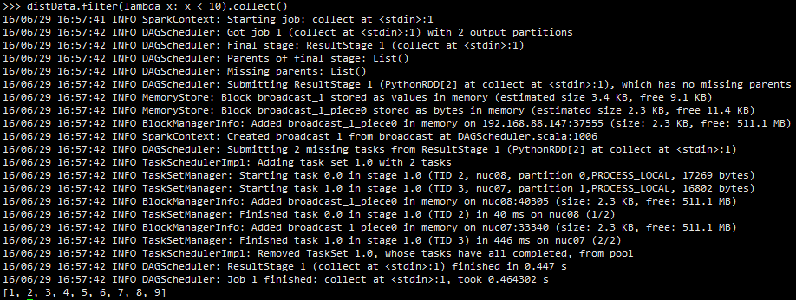
2. Apache Spark - Test on NUC 1
# Start PySpark
cd ..
bin/pyspark
# See if PySpark is running well
data = range(1, 10001)
distData = sc.parallelize(data)
distData.filter(lambda x: x < 10).collect()

Slide 24
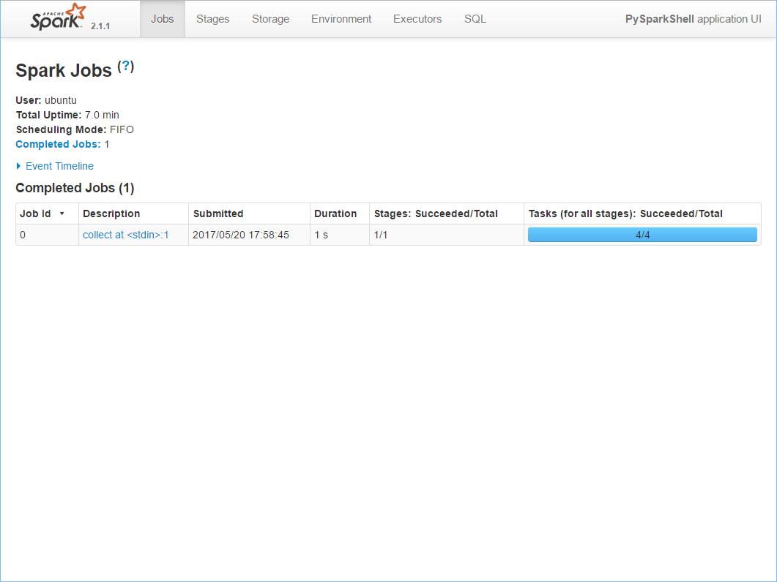
2. Apache Spark - Test on NUC 1
PySpark Web UI (http://<NUC 1 Address>:4040) showing a job

Slide 25
3. Apache Zeppelin on Mesos - Install on NUC 1
1. Turn off if PySpark is still running
quit()
2. Install Apache Zeppelin and its prequisitories
cd ~
wget http://apache.mirror.cdnetworks.com/zeppelin/zeppelin-0.7.3/zeppelin-0.7.3-bin-all.tgz
tar xzf zeppelin-0.7.3-bin-all.tgz
cd zeppelin-0.7.3-bin-all
cp conf/zeppelin-env.sh.template conf/zeppelin-env.sh
3. Update “zeppelin-env.sh” file to configure Apache Zeppelin
vi conf/zeppelin-env.sh
export MESOS_NATIVE_JAVA_LIBRARY="/usr/local/lib/libmesos.so"
export MASTER="mesos://<NUC 01 IP Address>:5050"
export SPARK_HOME="/home/<Your Linux ID>/spark-2.2.1-bin-hadoop2.7"
4. Start Apache Zeppelin daemon
bin/zeppelin-daemon.sh start
Notes:
cluster

Slide 26
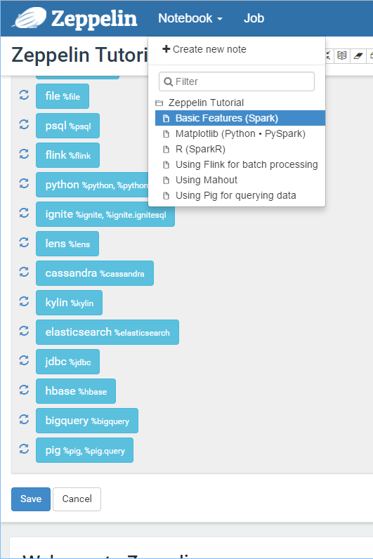
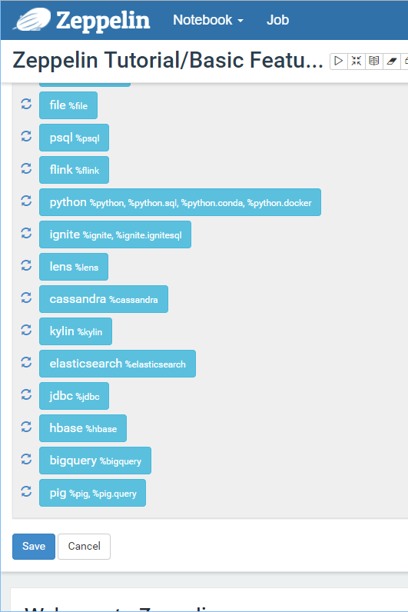
3. Apache Zeppelin - Run Example
Open its Web UI (http://<NUC 1 Address>:8080) and
Run tutorial, Press ‘Run’ button to test.
1.
2.

Slide 27
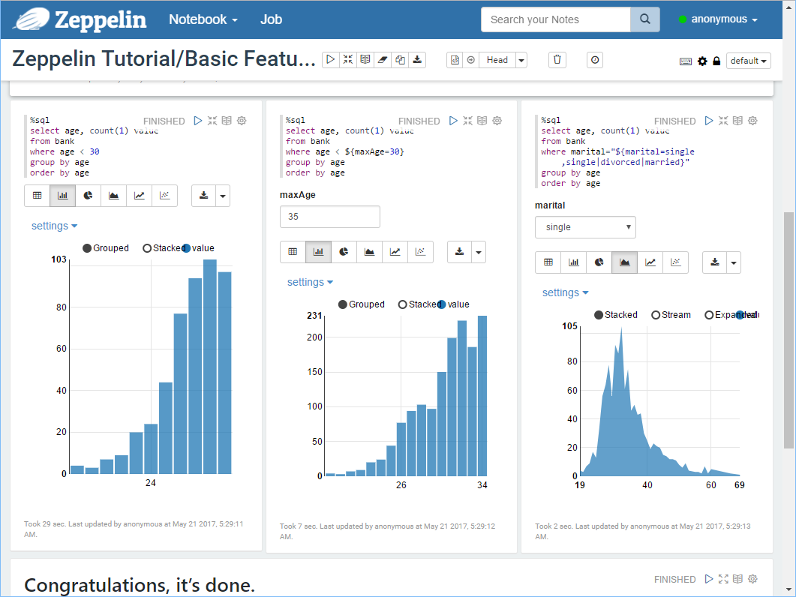
3. Apache Zeppelin - Run Example
The tutorial will run like this, if all is successful.

Slide 28
3. Apache Zeppelin - Tip: Zeppelin Standalone mode
If you have trouble running Zeppelin on Mesos, or have only one machine, then you can run Zeppelin in standalone mode.
If you already made configuration file, remove it first.
rm conf/zeppelin-env.sh
Without any configuration, just start Zeppelin daemon.
bin/zeppelin-daemon.sh start
#(or if daemon is already running, use ‘restart’ instead of ‘start.’)

Slide 29
4. HDFS (Optional) - Install
HDFS NameNode
HDFS DataNode
HDFS DataNode

Slide 30
4. HDFS (Optional) - Installation Procedure
Set hostnames
Configure accounts and SSH settings
Download and Unzip Hadoop
Configure HDFS
Start and test

Slide 31
04-1. HDFS - Configure accounts and install SSH
Do this for all NUCs.
Install SSH package and start SSH daemon
sudo apt –y install ssh && sudo systemctl start ssh
Set root password
sudo passwd
Create Hadoop account and exit from root account
sudo -s
adduser hadoop
adduser hadoop sudo
exit
We will use only hadoop account for HDFS chapter.

Slide 32
4-1. HDFS - Configure accounts and SSH settings
From NUC 1 :
1. Log in to user ‘hadoop’.
su hadoop
2. Generate key (just press enter x 3) in NUC 1
ssh-keygen -t rsa
cp /home/hadoop/.ssh/id_rsa.pub /home/hadoop/.ssh/authorized_keys
3. Modify key permission
cd ~/.ssh && chmod 644 authorized_keys
4. Copy key from NUC 1 to NUC 2
ssh hadoop@<NUC 2 IP Address> mkdir –p \~/.ssh
scp authorized_keys hadoop@<NUC 2 IP Address>:~/.ssh/
5. Login via SSH with hadoop account to check if you can login to NUC 2 without password and exit.
ssh hadoop@<NUC 2 IP Address>
exit

Slide 33
4-1. HDFS - Download and Unzip Hadoop
1. Download and Unzip in all NUCs.
cd ~
wget http://apache.mirror.cdnetworks.com/hadoop/common/hadoop-2.8.0/hadoop-2.8.0.tar.gz
tar -xvzf hadoop-2.8.0.tar.gz
sudo mv hadoop-2.8.0 /usr/local/hadoop
2. From NUC 1, Go to the directory which contains configuration files.
cd /usr/local/hadoop/etc/hadoop
We will edit these files:
hadoop-env.sh, core-site.xml, hdfs-site.xml, slaves

Slide 34
4-1. HDFS - Configuration
For all NUCs, Open these files and update to the followings :
1. “hadoop-env.sh” file
export JAVA_HOME="/usr/lib/jvm/java-8-oracle"
Edit:
2. “core-site.xml” file
Edit:
...
<configuration>
<property>
<name>fs.defaultFS</name>
<value>hdfs://nuc01:9000/</value>
</property>
</configuration>
...
The value must specify a hostname, not IP address.

Slide 35
4-1. HDFS - Configuration
3. “hdfs-site.xml” file
Edit:
...
<configuration>
<property>
<name>dfs.replication</name>
<value>2</value>
</property>
<property>
<name>dfs.namenode.name.dir</name>
<value>file:///usr/local/hadoop/namenode</value>
</property>
<property>
<name>dfs.datanode.data.dir</name>
<value>file:///usr/local/hadoop/datanode</value>
</property>
</configuration>
...
4. “slaves” file: Add IP address of all NUCs
Edit:
(Remove localhost)
<NUC 1 IP Address>
<NUC 2 IP Address>

Slide 36
4-1. HDFS - Configuration
Deploy configuration files from NUC 1 to NUC 2.
cd ..
scp -r hadoop hadoop@<NUC 2 IP Address>:/usr/local/hadoop/etc/
In all NUCs, make DataNode directory.
mkdir /usr/local/hadoop/datanode
In all NUCs, edit /etc/environment file.
sudo vi /etc/environment
Add this line at the end of the paths, and close with ”.
:/usr/local/hadoop/bin
Ex) PATH=“/usr/local/sbin:/usr/local/bin: … :/sbin:/bin:/usr/local/hadoop/bin”
And append the hadoop path with the following command :
export PATH=$PATH:/usr/local/hadoop/bin

Slide 37
4-1. HDFS - Start and Test
From NUC 1, login to ‘hadoop’. (Pass if already using it)
su hadoop
Format NameNode.
hdfs namenode -format
Start HDFS.
/usr/local/hadoop/sbin/start-dfs.sh
Make a directory and upload a file to HDFS to check if it is working.
hadoop fs -mkdir /user
hadoop fs -put ~/hadoop-2.8.0.tar.gz /user/
hadoop fs -ls hdfs://<NUC 1 IP Address>:9000/user/
# Try the last command on both NUCs.
You can also see on the web:
http://<NUC 1 IP Address>:50070

Slide 38
4-2. Apache Spark with HDFS - Configuration
Put the Apache Spark file into the HDFS and switch back to your ID.
cd /home/<Your Linux ID>
hadoop fs -put spark-2.1.1-bin-hadoop2.7.tgz /user/
exit
Stop Previous Apache Zeppelin if it’s still running.
~/zeppelin-0.7.1-bin-all/bin/zeppelin-daemon.sh stop
Change the following variable from the previous Apache Spark config :
cd ~/spark-2.1.1-bin-hadoop2.7
vi conf/spark-env.sh
Edit:
export SPARK_EXECUTOR_URI="hdfs://<NUC 1 IP Address>:9000/user/spark-2.1.1-bin-hadoop2.7.tgz"
Test Spark
bin/pyspark
data = range(1, 10001)
distData = sc.parallelize(data)
distData.filter(lambda x: x < 10).collect()
Go to Mesos web UI and see Spark framework running.

Slide 39

4-2. Apache Spark with HDFS - Run Example from Apache Zeppelin
Close PySpark with quit() and in Zeppelin directory,
bin/zeppelin-daemon.sh start
Run Zeppelin tutorial to test changed configurations.

Slide 40

Thank You for
Your Attention
Any Questions?

